Slide 1



FOOD PRICE, BD.
Assalamualaikum
Project Name:
Food Price Across Bangladesh
https://foodpricesbd.42web.io/
01

Slide 2

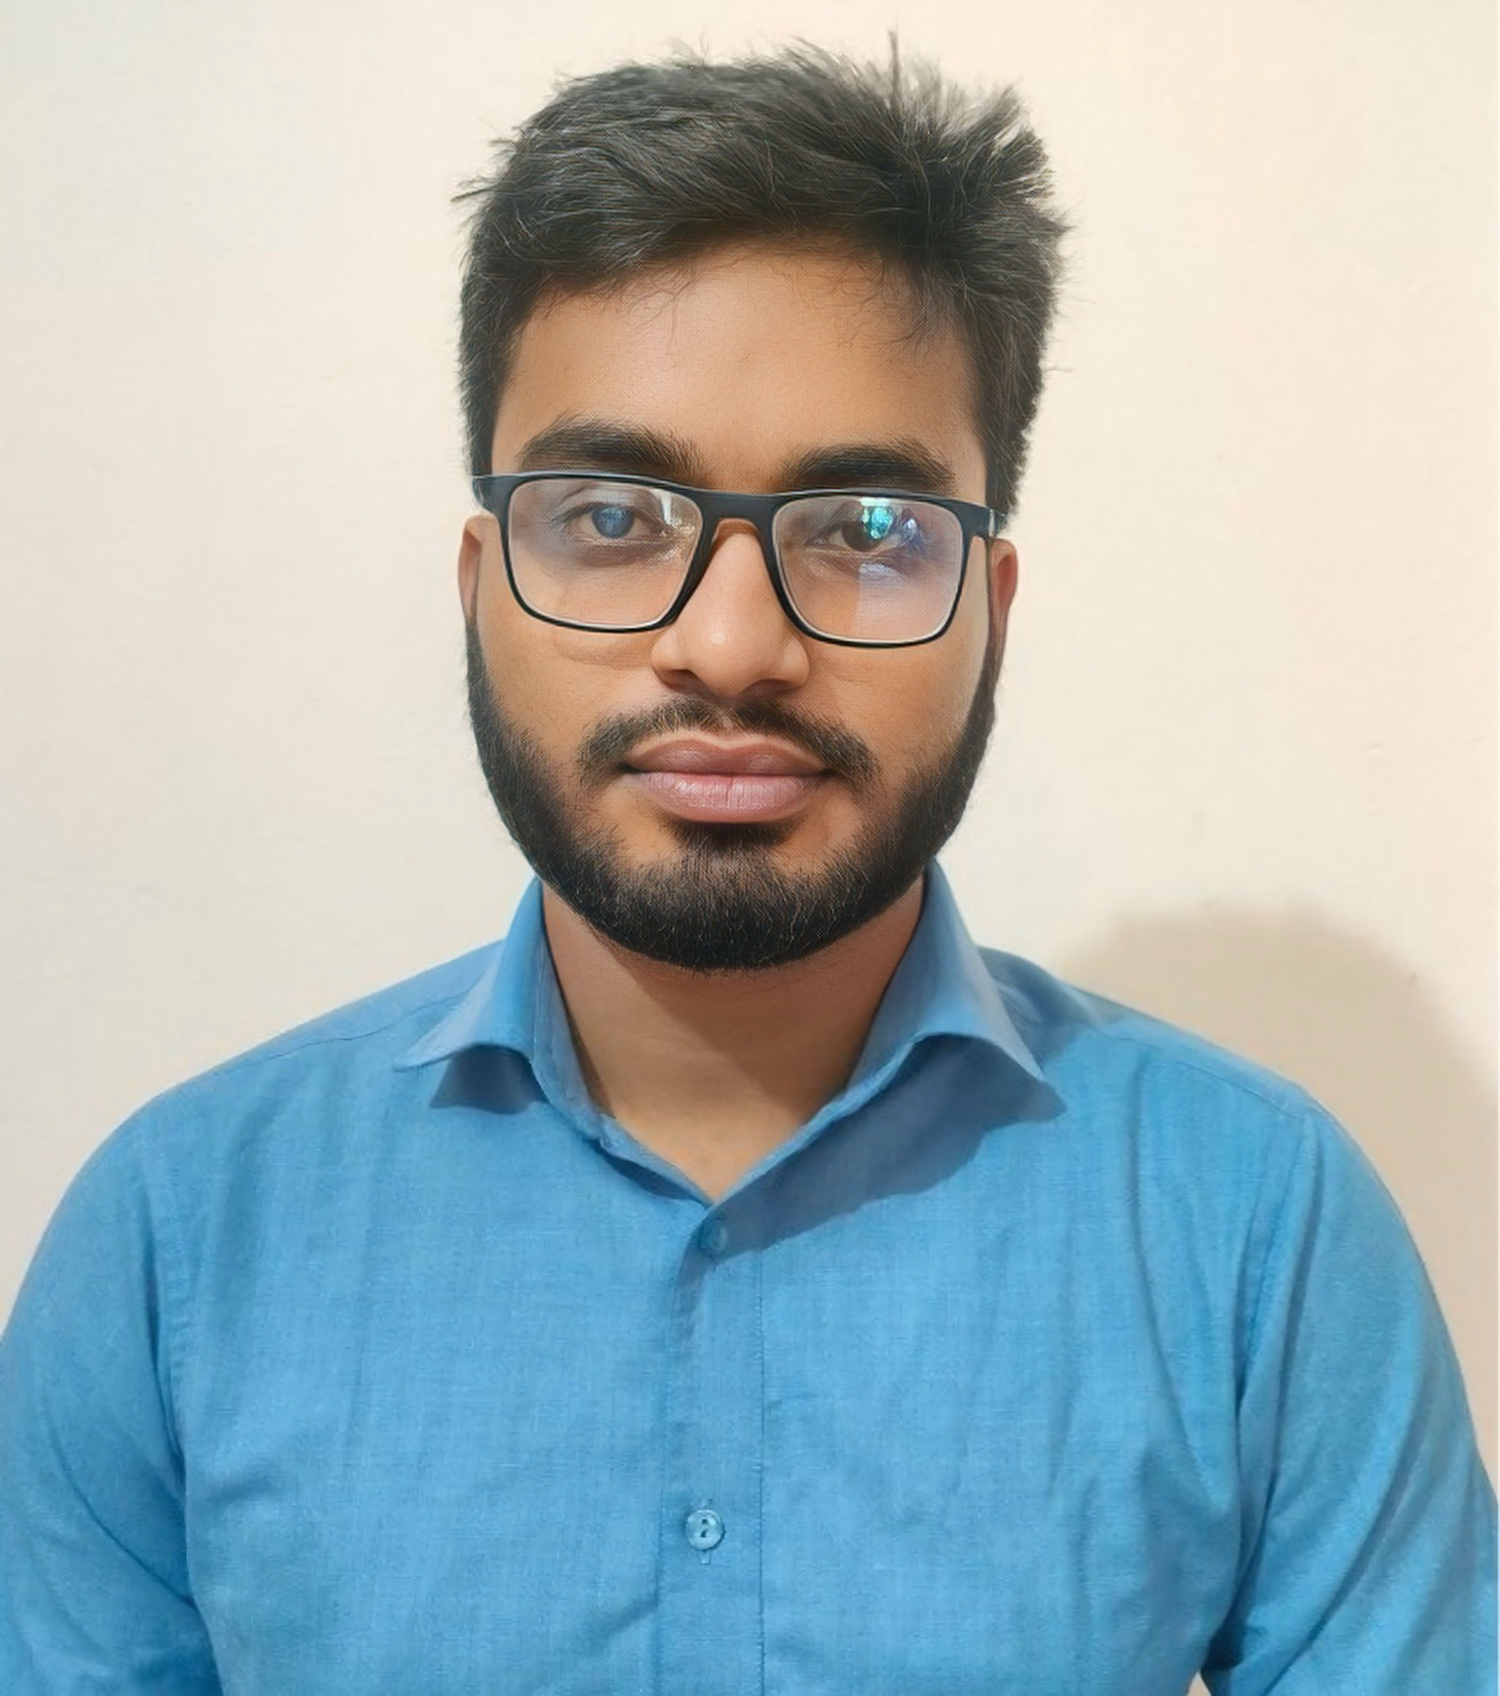

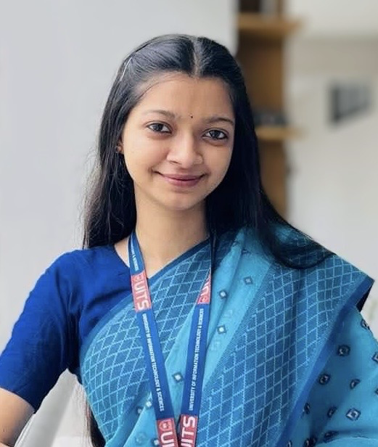

Presented By
Md Shakib Ahamed
Id:2215151130
Md.Omayer Hasan Muhit
Id:2215151135
Rawnak Tasnim Ruku
Id:2215151152
Sayeda Ferdoushi Islam
Id:2215151148
02

Slide 3
Presented To :
Engineer Md. Safaet Hossain
Associate Professor
Department of CSE,UITS
Propa Punam
Lecturer,
Department of CSE,UITS
03

Slide 4

CONTENT
Slide no.
01
Introduction
05
02
Product Features
06
03
07
User Classes and Characteristics
04
08
System Features
05
09
Design Overview
06
10-21
Diagrams
07
Development Constraint
22
08
Security Measures
23
09
Summery
24
10
Website Demo
25-27
04

Slide 5



Introduction
Scope:
• Covers all food categories and districts.
• Provides real-time updates and secure access for admins.
Project Purpose:
• A platform for viewing food prices across 64 districts in Bangladesh.
• Allows complaints and admin updates on prices.
05

Slide 6





Project Features
• Food price tracking (real-time and historical).
• Admin updates with secure access.
• Mobile-friendly interface.
• User complaint system.
• Price trends with detailed graphs.
• District-specific data navigation.
Key Features:
06

Slide 7
User Classes and Characteristics
View food prices and trends.
File complaints.
Access from any device.
General Users
Manage and update price data.
Require secure, restricted access.
Handle large-scale updates efficiently.
Admins
07

Slide 8

System Features
• District-wise price display.
• Real-time data updates by admins.
• User authentication (admins vs. general users).
• Responsive, mobile-friendly interface.
Functional Requirements
• Fast response time (<3 seconds).
• Scalability for growing data.
• Multi-factor authentication for admins.
• AES-256 encryption for data security.
Nonfunctional Requirements
08

Slide 9
Design Overview
• Technologies: PHP, CSS, JavaScript, Bootstrap.
• Modern browsers, responsive design.
Frontend
• Server: HTTPS, Cloud hosting.
• Database: MySQL
• Framework: PHP (Laravel).
Backend
09

Slide 10
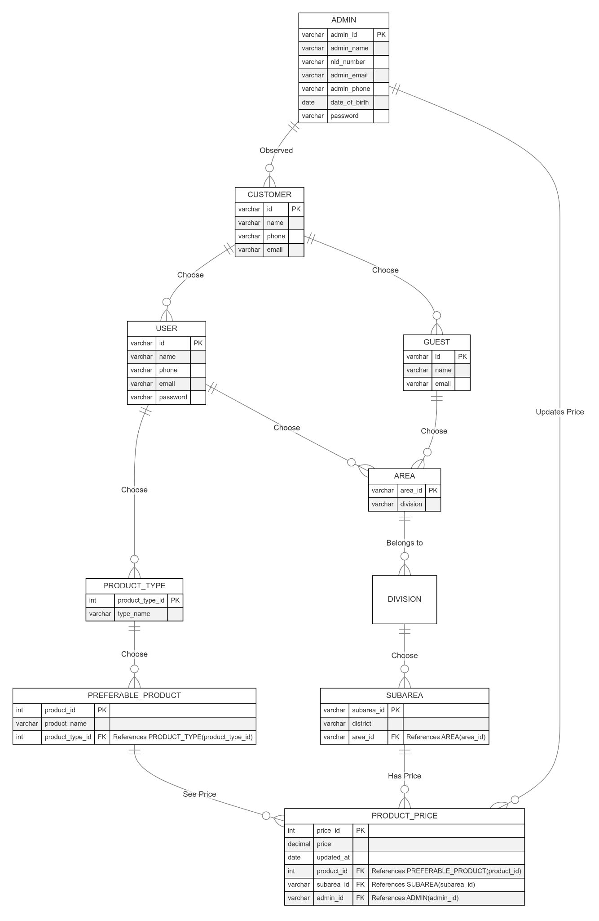
Diagrams
ER Diagram
10

Slide 11
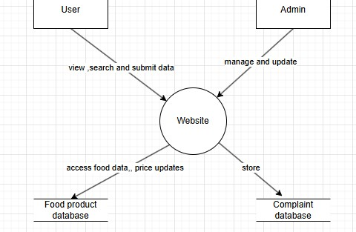
Diagrams
DFD_0
11

Slide 12
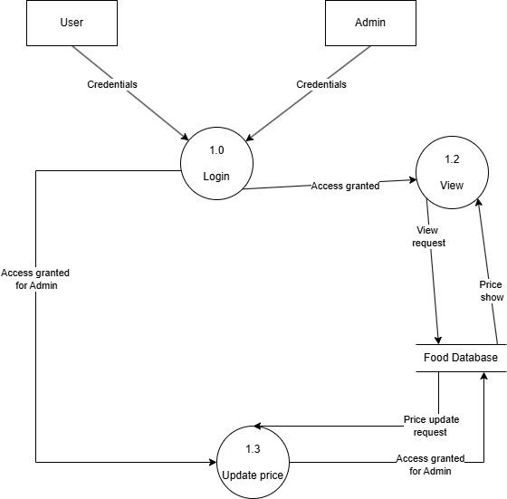
Diagrams
DFD_1
12

Slide 13
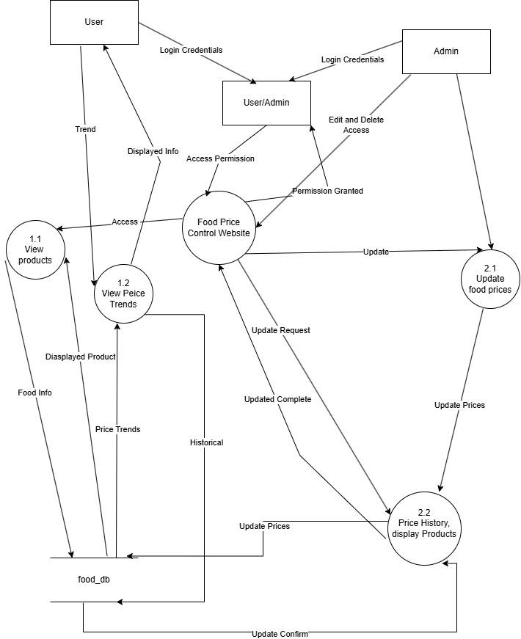
Diagrams
DFD_2
13

Slide 14
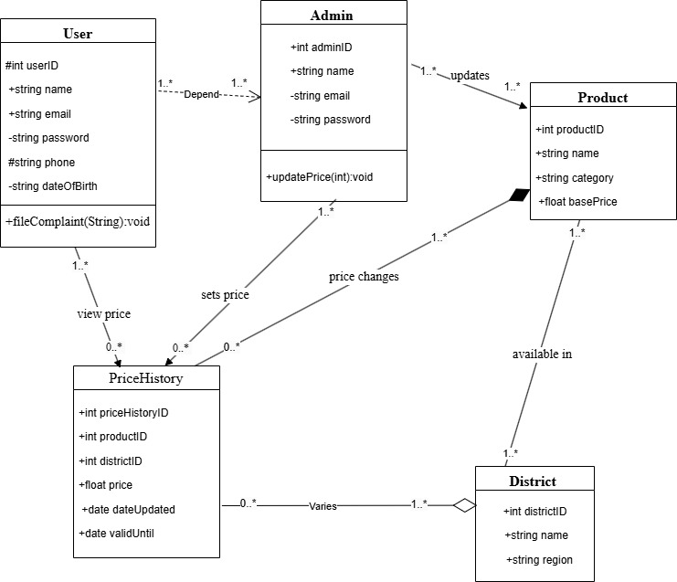
Diagrams
Class Diagram
14

Slide 15
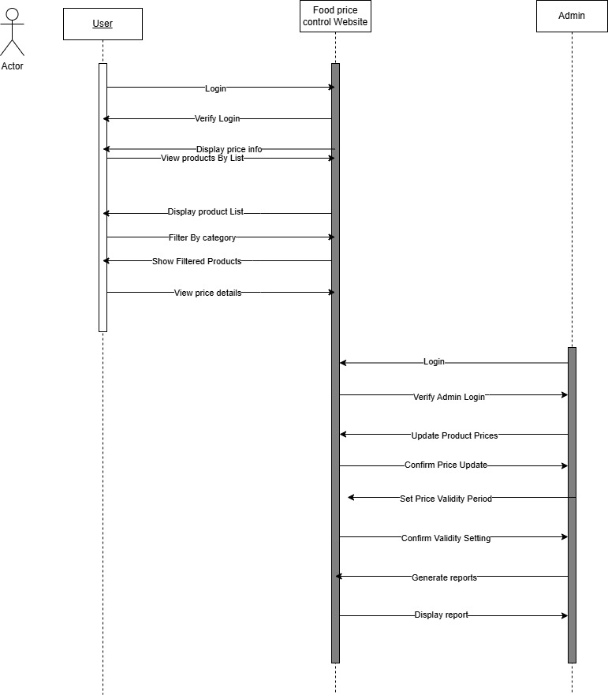
Diagrams
Sequence Diagram
15

Slide 16
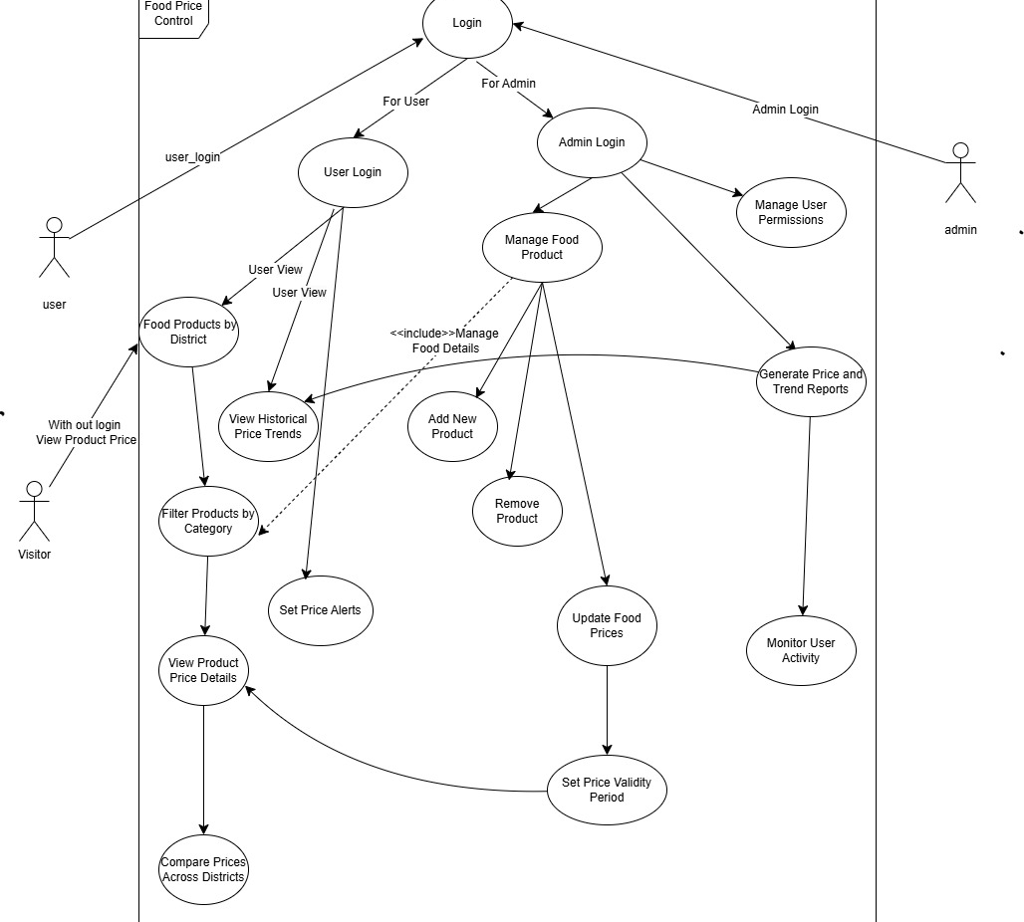
Diagrams
Use_case Diagram
16

Slide 17
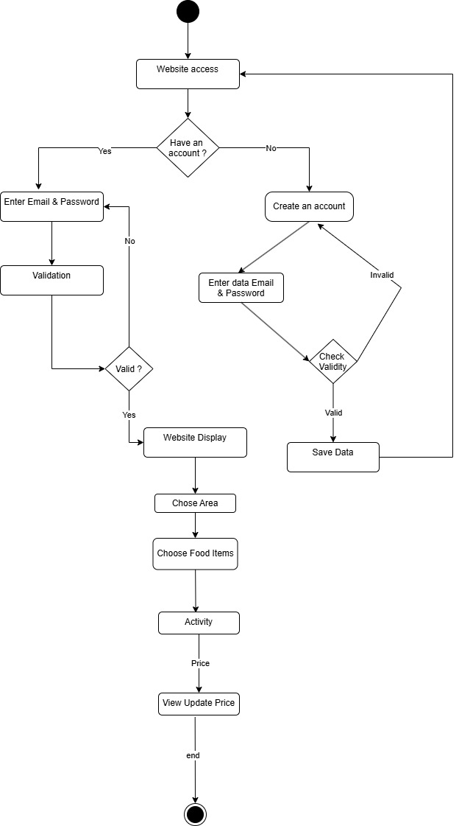
Diagrams
Activity Diagram
17

Slide 18
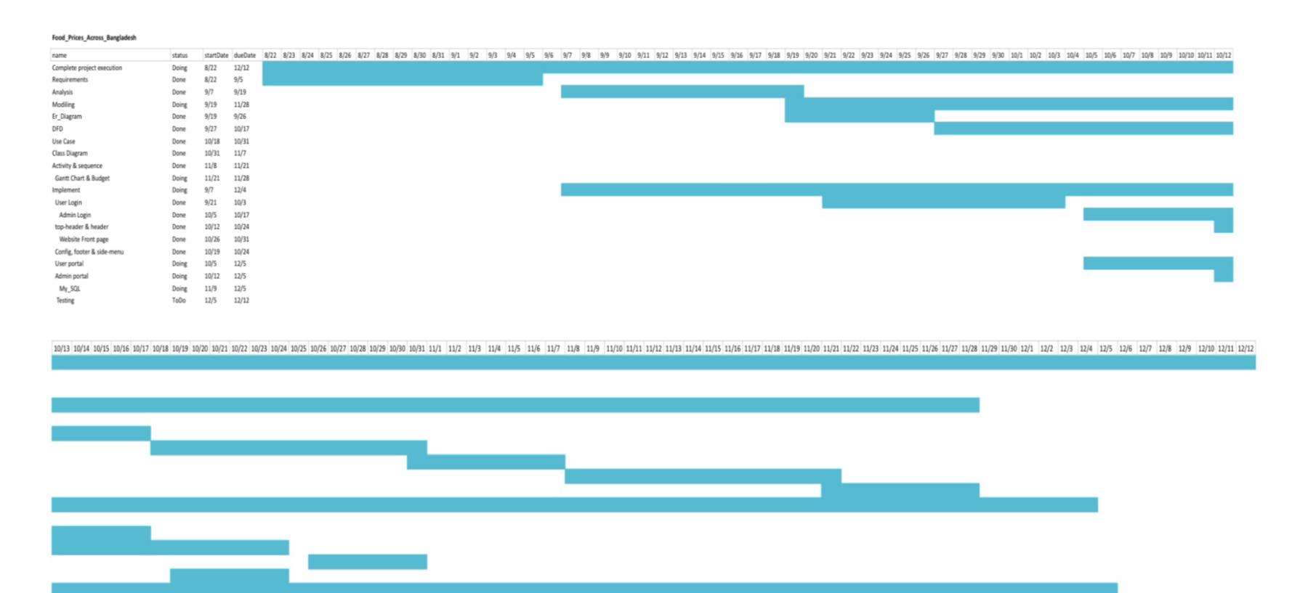
Diagrams
Gantt_chart
18

Slide 19
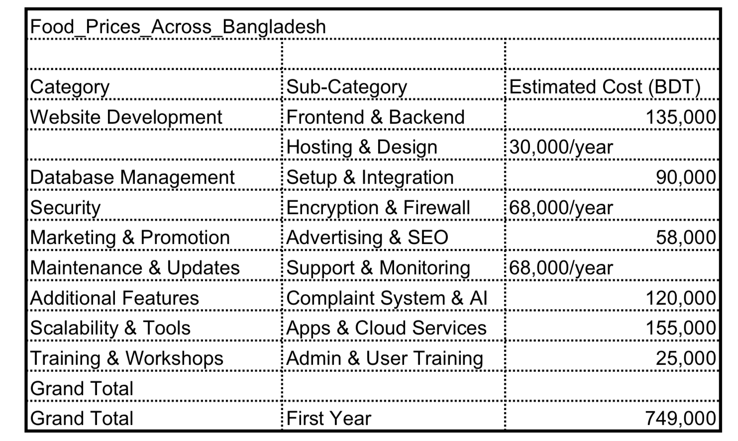
Diagrams
Budget_details
19

Slide 20
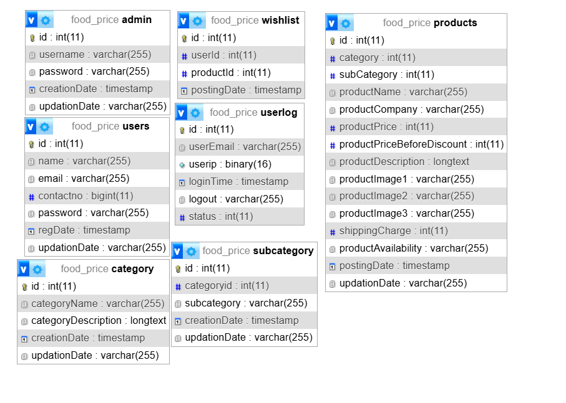

Diagrams
Databases
20

Slide 21
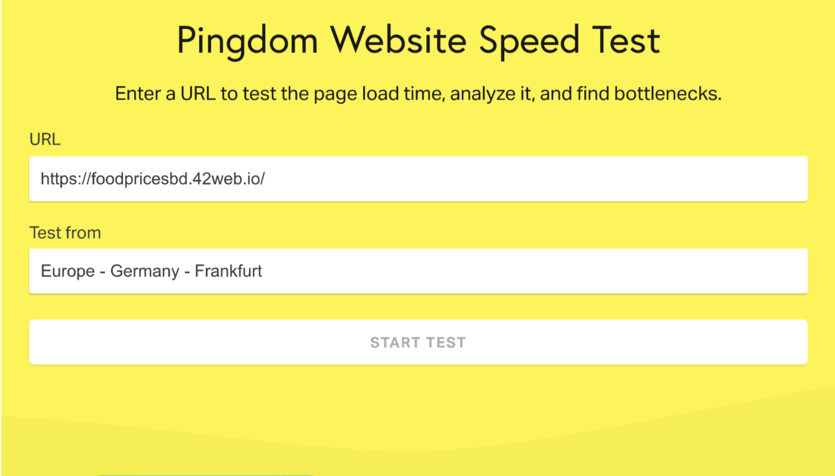
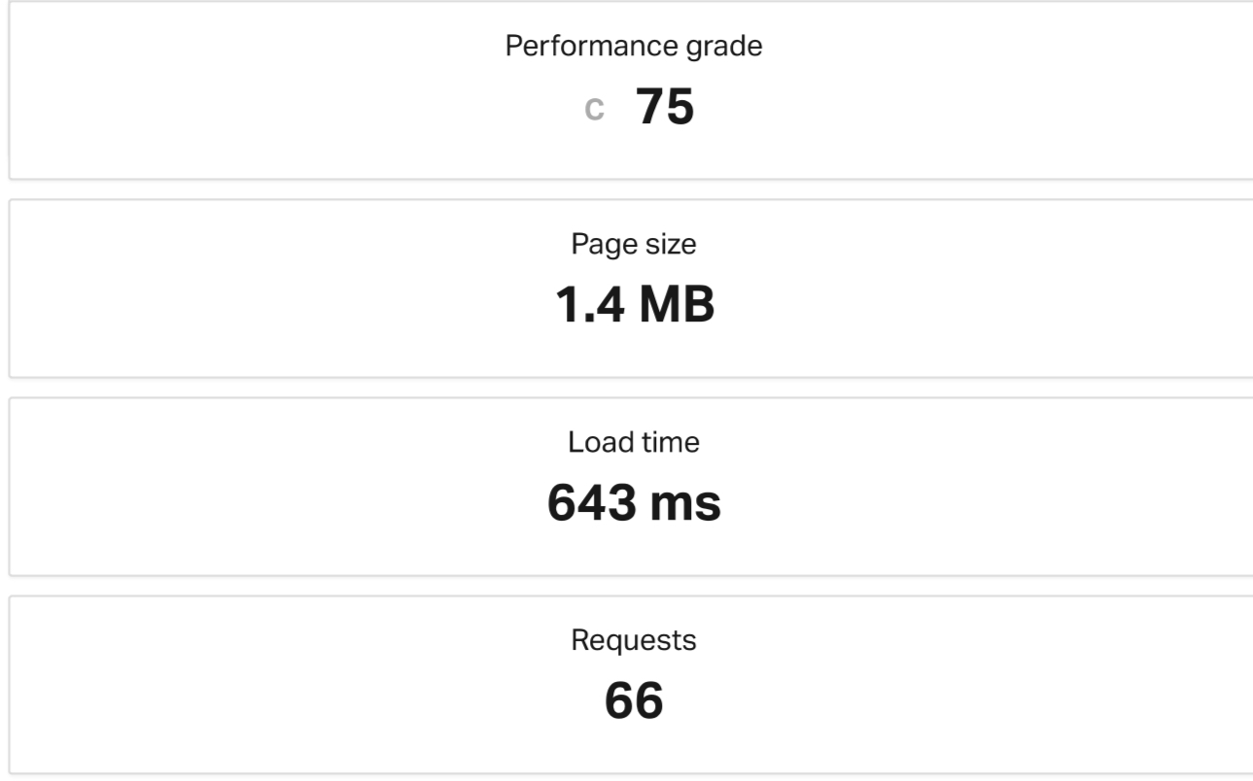
Diagrams
Website testing report
21

Slide 22

Development Constraint
Key Constraints:
• Internet dependency for real-time updates.
• Database scalability and performance.
• Regulatory compliance with Bangladeshi data laws.
22

Slide 23



Security Measures
• Multi-factor authentication.
• Encrypted communication with TLS.
• SQL injection prevention.
• Role-based access control (RBAC).
• Data encryption using AES-256.
• HTTPS for all transmissions.
• Firewalls and regular updates.
Admin Security
Database Security
System Security
23

Slide 24

Summery
• Comprehensive food price tracking.
• District-specific and trend analysis.
• Secure, user-friendly platform.
• Expand to include more categories and regions.
• Integrate predictive analysis for future price trends.
Achievements
Future Goals
24

Slide 25
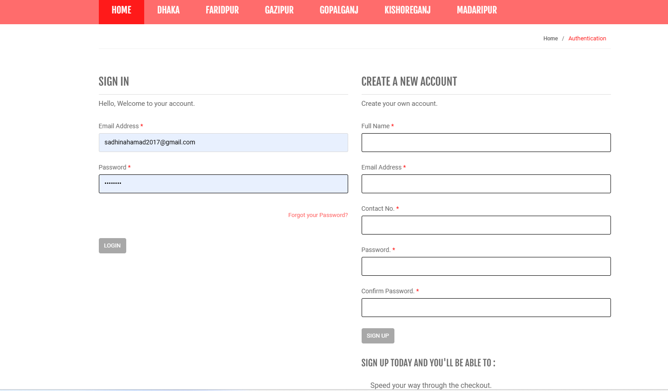
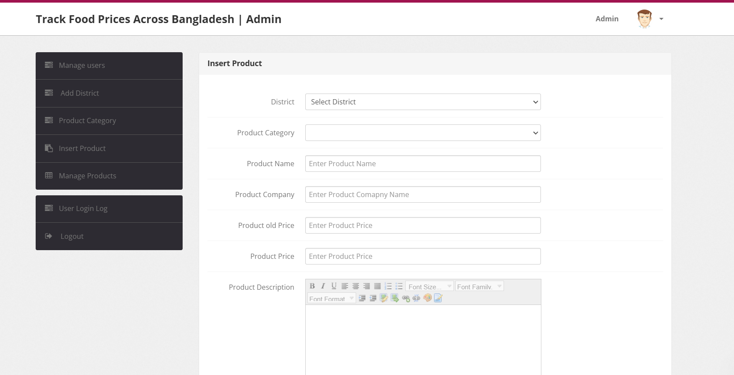
Website Demo
25

Slide 26
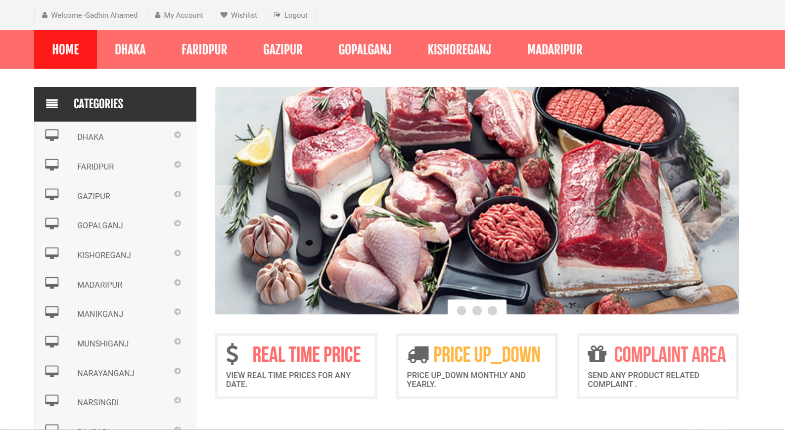
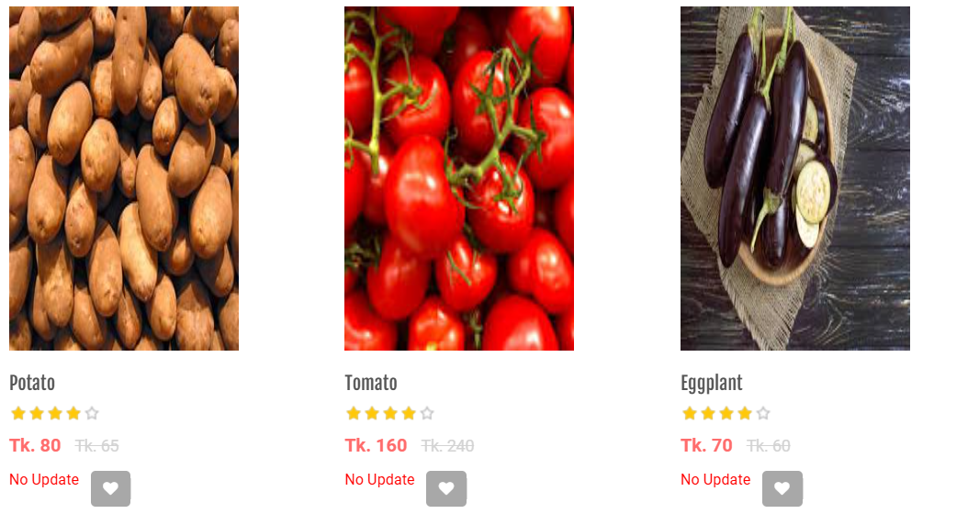
Website Demo
26

Slide 27

THANK YOU FOR YOUR TIME EVERYONE
FOOD PRICE, BD.
27

